Slide 1

Predicting Happiness
By Backrow Team:
John Chapek
Donatienne Noel
Claudia Palmer-Martinez
Alexandra Solano

Slide 2
Introduction
The project is based on The World Happiness Report issued annually by the United Nations. This concept goes well with the idea of Machine Learning because it is an attempt to quantify human emotion.
Respondents in each country were asked a basic question: "Imagine that life is a ladder, with the bottom rung being the worst life you can imagine and the top rung being the best life you can imagine, where are you on the ladder?”

Slide 3
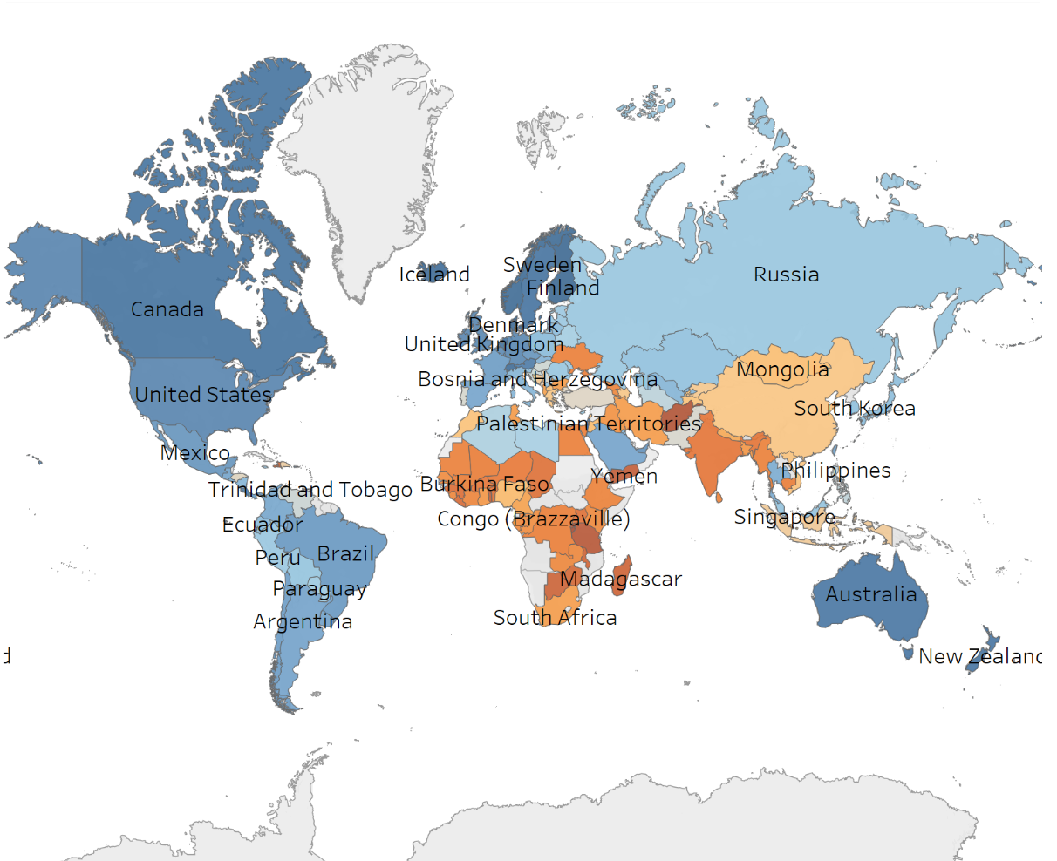
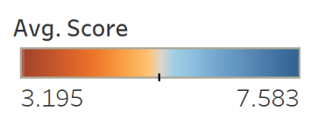

Slide 4
Purpose
The purpose of the project is to utilize machine learning to predict country happiness taking into consideration the factors utilized in the report.
This has also been used a tool that has been used for policy making, for example, in the health care industry with regards to the treatment of mental health.

Slide 5

Methodologies Utilized
Linear Regression
Random Forest Regression
It should be noted that in all models, data from the years 2005 - 2019 were used to train the models and data from the year 2020 was used to test the models.

Slide 6
Variables
GDP Per Capita
Social Support
Healthy Life Expectancy
Freedom to Make Life Choices
Generosity
Perception of Corruption

Slide 7
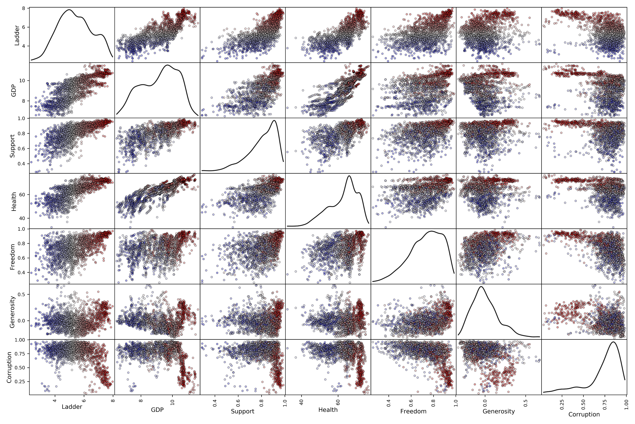
D a t a E x p l o r a t I o n

Slide 8
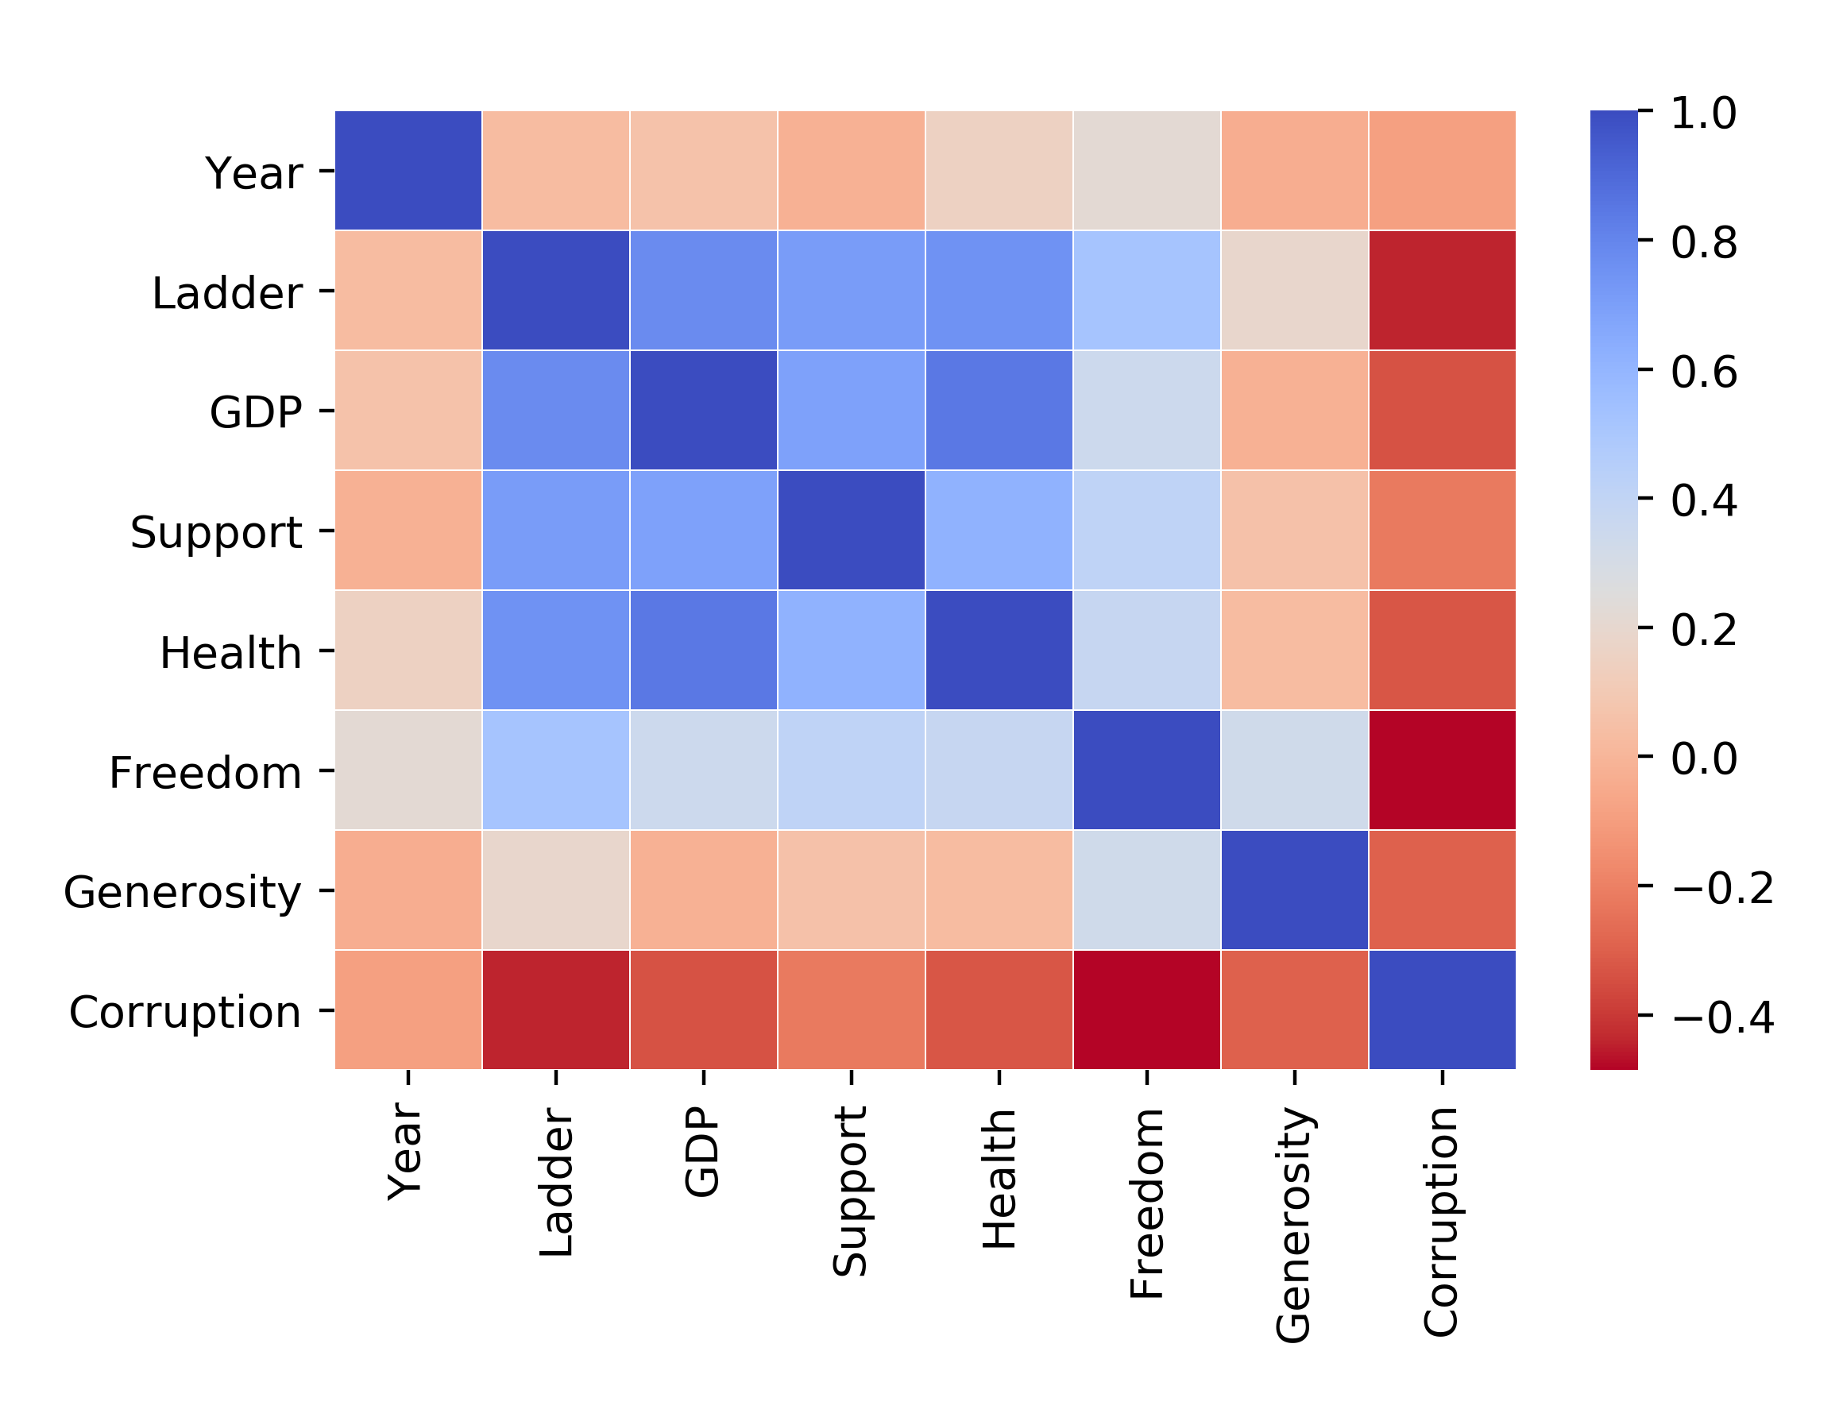
D a t a E x p l o r a t I o n
Feature Selection:
Correlation Matrix
Strongest correlations with the target variable are GDP, Support, and Health
(with 0.778, 0.710, and 0.751)
A bit weaker correlated are Freedom, Generosity, and Corruption
(with 0.522, 0.191 and -0.442)
The highest correlation between features is between GDP and Health with 0.844
No features have a correlation greater than 0.9, so no features will be dropped based on the correlation matrix

Slide 9
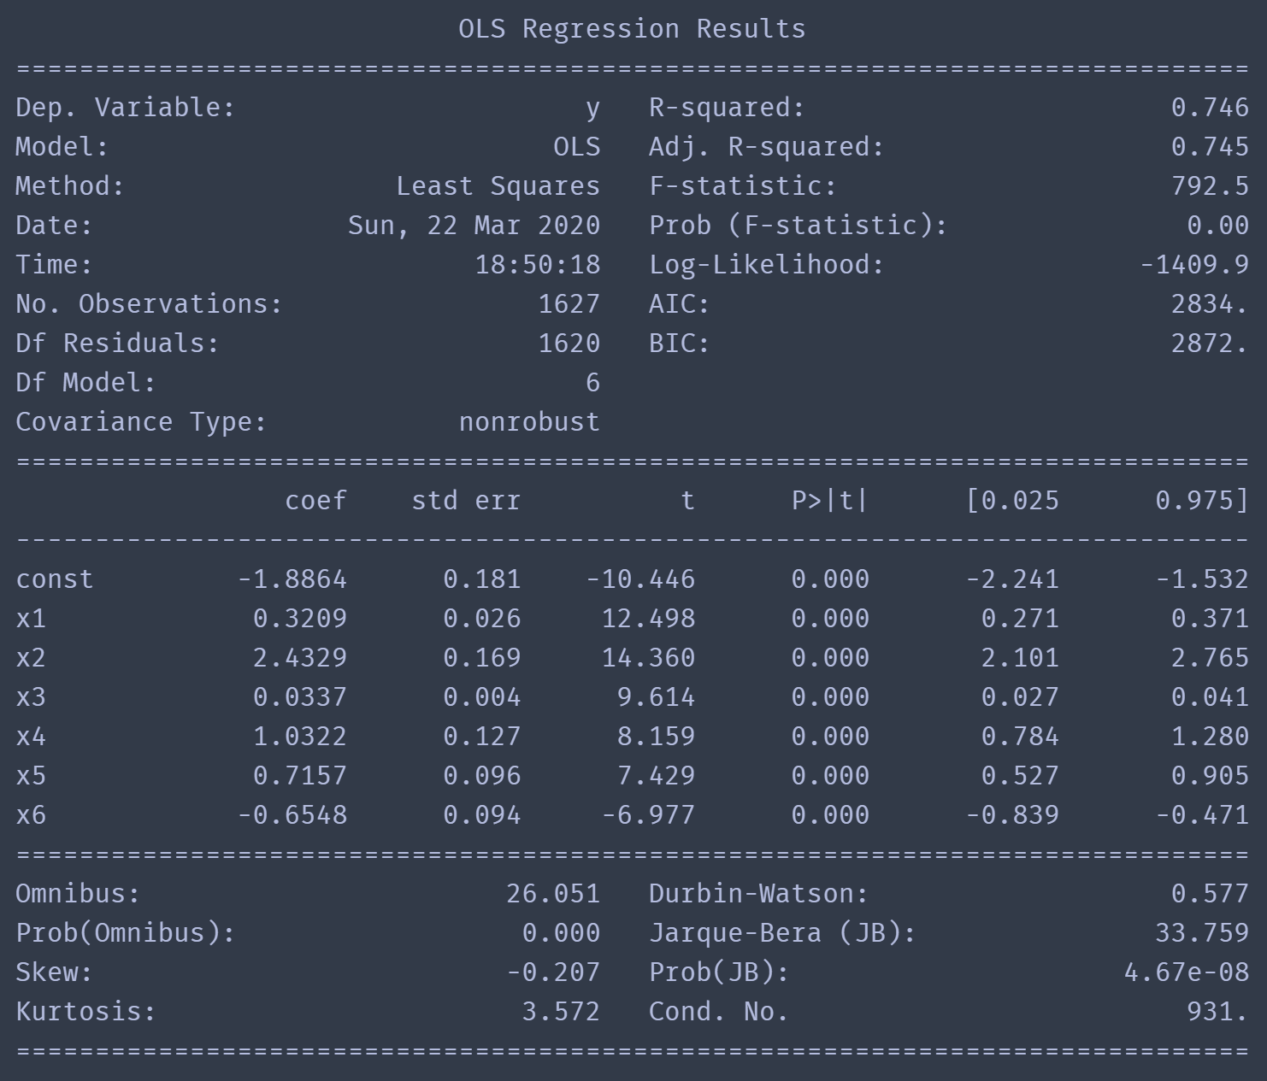
D a t a E x p l o r a t I o n
Feature Selection:
P-values in Linear Regression
P-values for each term test the null hypothesis that the coefficient for the corresponding feature is zero (feature has no effect on the response variable)
A low p-value, typically less-than 0.05, indicates the corresponding feature is a meaningful addition to your linear model
Here again, all features are kept

Slide 10

Multivariable Linear Regression
Feature Scaling was not required for sklearn’s LinearRegressor regressor
Train-Test-Split was achieved with:
Training Set: Years 2005 – 2019
Test Set: Year 2020
Using all the features in a linear regression we obtained a score of R² = 0.745 on the training set and a score of R² = 0.736 on the test set
The adjusted R² on the test set was R²_{adjusted} = 0.727
Feature Removed | R²_{adjusted}
None | 0.727
GDP | 0.714
Support | 0.691
Health | 0.714
Freedom | 0.715
Generosity | 0.723
Corruption | 0.722

Slide 11
Random Forest Regression
A Random Forest is an ensemble technique capable of performing both regression and classification tasks with the use of multiple decision trees and a technique called Bootstrap Aggregation, commonly known as bagging, which involves training each decision tree on a different data sample where sampling is done with replacement.
The steps taken where to:
Import and clean data with Pandas
Convert Data to Numpy Arrays and Divide Data between Features (variables) and Target (value to be predicted)
Split Data for Training (75%) and Testing (25%) using Scikit-learn
Establish a Baseline: A sensible measure that we hope to beat with our model. In this case, our baseline error was 3.7. This provides a goal for the methodology.
Train the model to learn relationships between the features and the targets: Using Scikit-learn, we use the random forest regression model, instantiate and fit the model on the training data.

Slide 12
Random Forest Regression - Continued
Make Predictions based on the Test set by calculating the Mean Absolute Error, which in our case was 0.32, therefore, beating our baseline.
Determine performance metrics by calculating the Mean Average Percentage Error (MAPE): This calculation yielded 93.79% indicating the accuracy of our model.
Interpret and Model Results:
(1) Visualize the decision trees: Single Decision Tree and a Reduced Size Tree, and
(2) Feature Importances: The representation of how much including a particular variable improves the prediction.
Tune the model

Slide 13
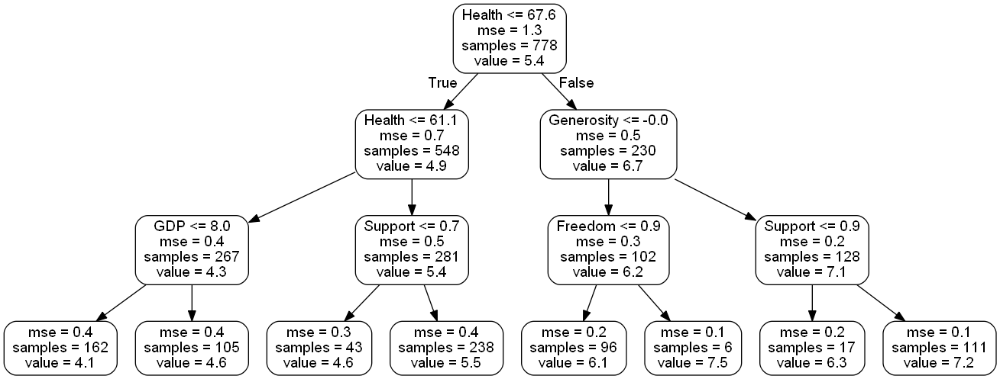
R
a
n
d
o
m
F
o
r
e
s
t

Slide 14
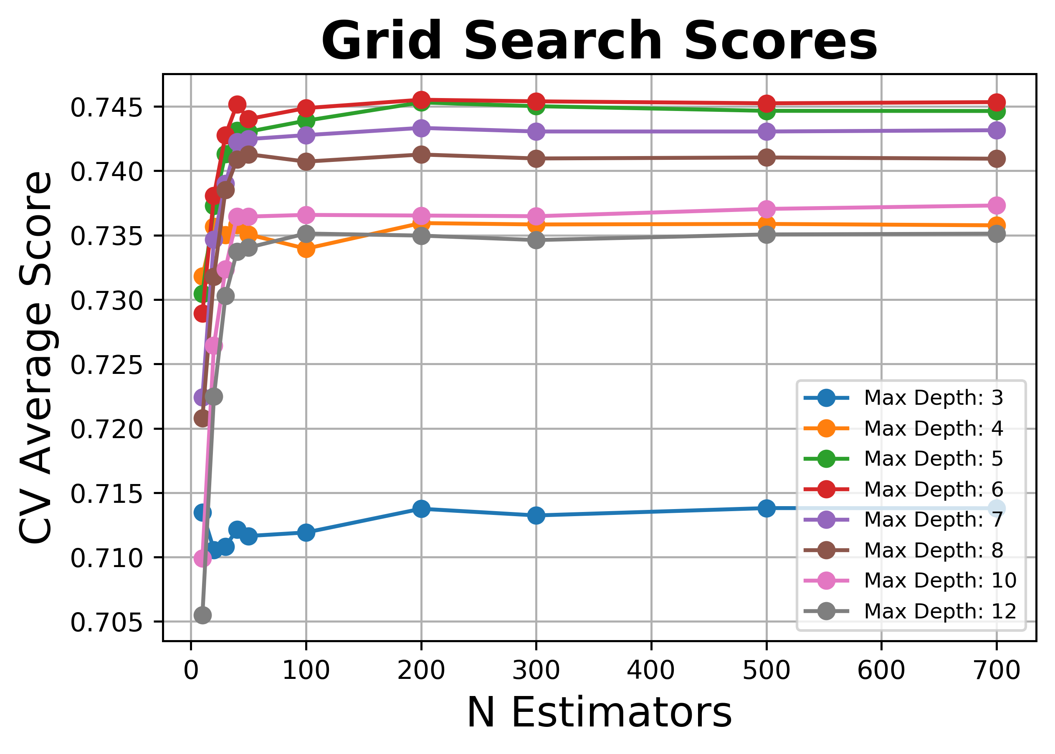
R a n d o m F o r e s t
Tuning Hyperparameters
GridSearchCV revealed that increasing n_estimators beyond a certain point did not improve accuracy. Increasing max_depth improved accuracy up to a certain point, then reduced it.
A more thorough GridSearch, the best parameters found are in the table below; yielding scores of R² = 0.911 on the training set and R² = 0.859 on the test set
The adjusted R² on the test set was R²_{adjusted} = 0.854
Hyperparameter | Tuned Value
n_estimators | 500
max_depth | 8
max_features | sqrt
min_sample_leaf | 1
min_sample_split | 2
bootstrap | True

Slide 15
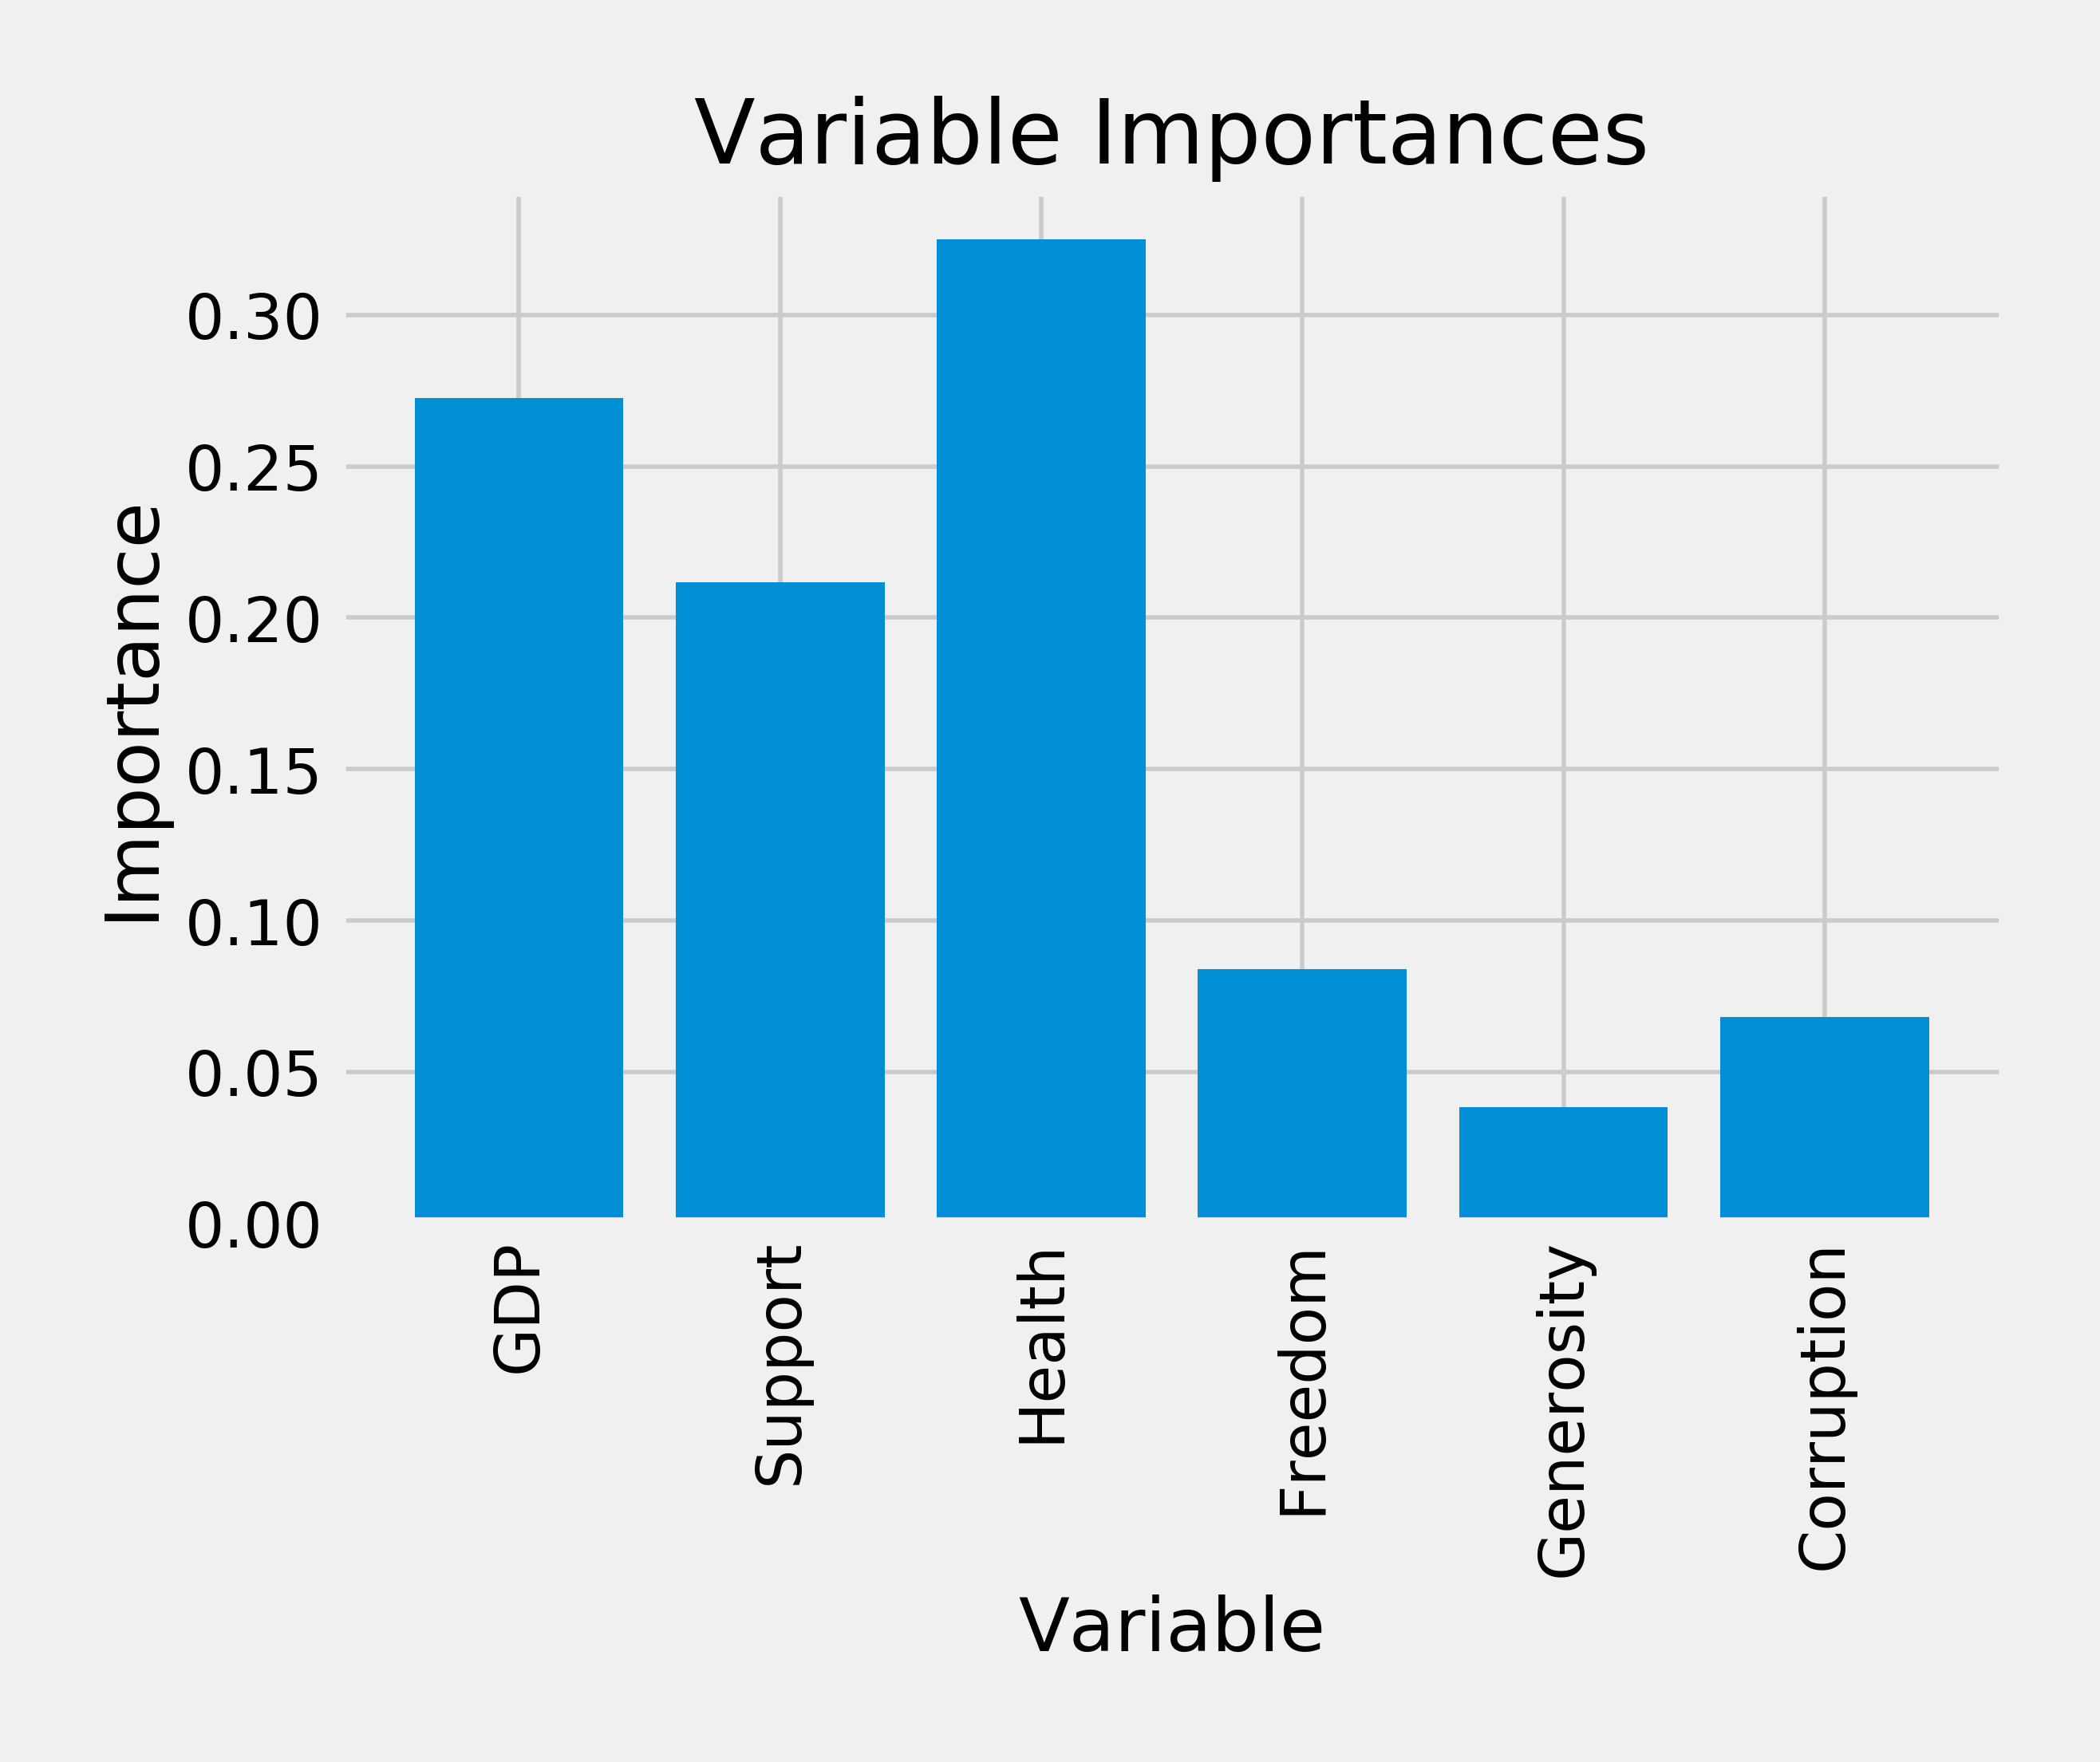
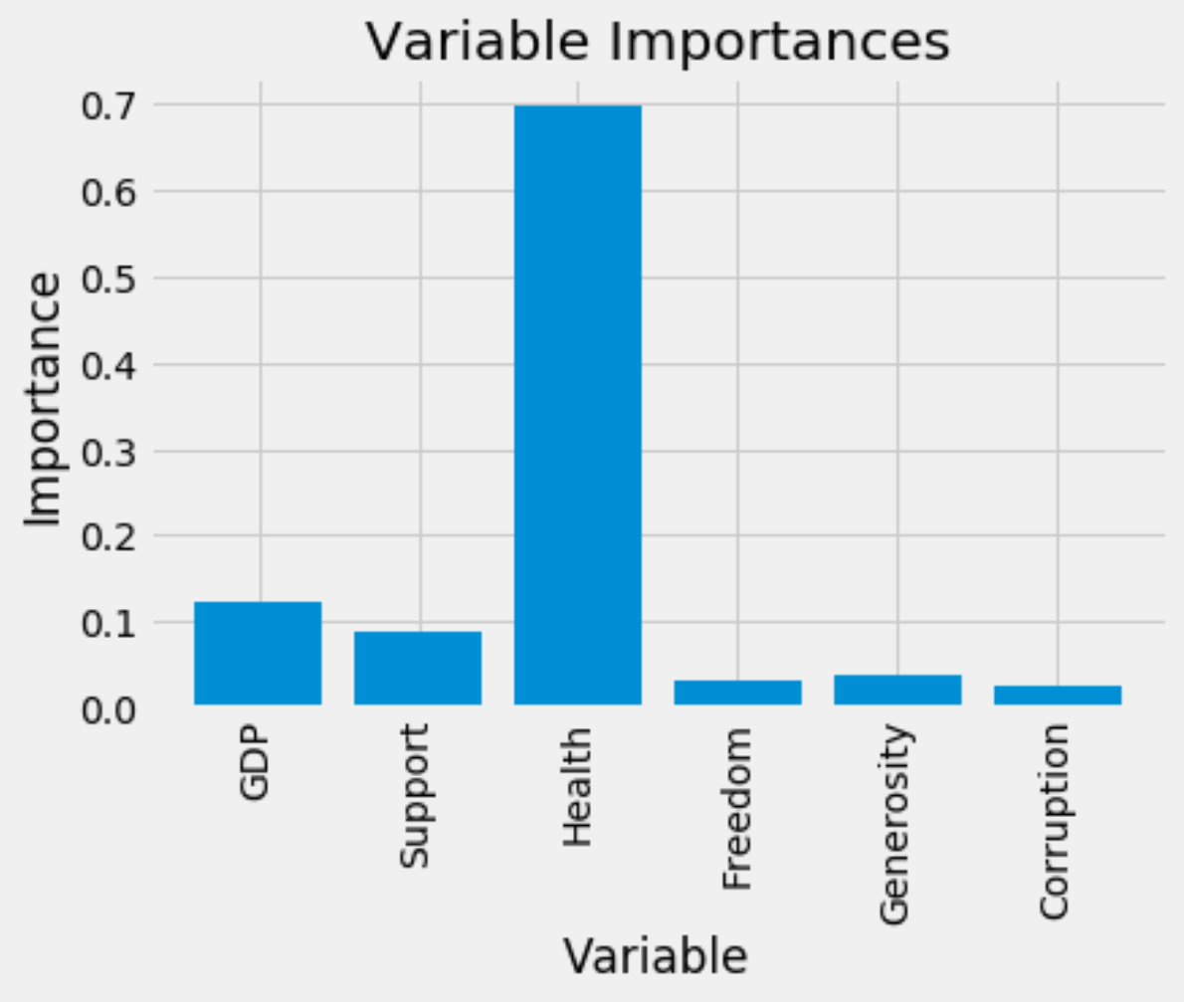
R a n d o m F o r e s t
Feature Importance
On par with the correlation matrix, Health, GDP, and Support being the most important (Health is ranked the most important here)

Slide 16
Conclusions
Methods of feature selection indicated all features were meaningful additions to models
(correlation matrix and p-values)
Linear Regression resulted in R²_{adjusted} = 73%
(higher than first project)
Feature importance in LR indicated Support to be most important feature, reducing score the most
(R²_{adjusted} = 69%)
Random Forest Regression was more accurate with R²_{adjusted} = 85% on the test set
Limiting the max_depth in RFR seemed to keep testing and training scores closer together, indicating less overfitting of the training set
Feature importance in RFR indicated Health to be the most important, followed by GDP and Support
Notes:
In linear regression, p values – statistically significant
Relying on adjusted R² calculations, when accounting for all variables, we have a certain value.
As we take away variables, we are able to see individual adjusted R² values
“Support” feature had an R² at 0.691.
Close relation to Ladder
Correlation matrix and scatter plots confirm this possibility
2 variables so closely related – Should they be dropped or combined? Health and GDP
When this was done, it did not improve the prediction at all.
The accuracy and adjusted R² went down
Feature Importance, using Python and Libraries SK Learn, we saw importance given to Health variable
GDP and Support and Health go hand in hand maybe
Random forest regression – more accurate than linear
Different paramaters
Adjust them to see how it affects accuracy or score
Increasing number of estimators = stability
Max depth – branching is limited beyond a certain point
Must set a max depth.
May cause larger difference between training R2 and test R2 --> an effect of overfitting data

